Slide 1
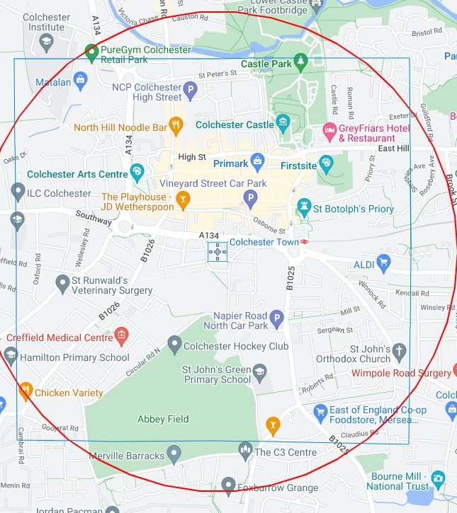

ONE
SQUARE
MILE
Heritage on our Doorstep

Slide 2

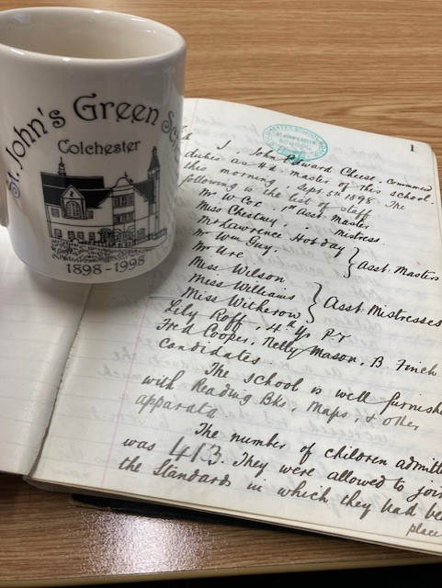
Tina Bourne,
Project Lead
How did we get here?
Celebration 125 years
Heritage & Community
Where can we go with this Project?
Your own PD, your own interest, enlivening the curriculum, relevant to every single child
Inclusive – Log Books are fascinating

Slide 3
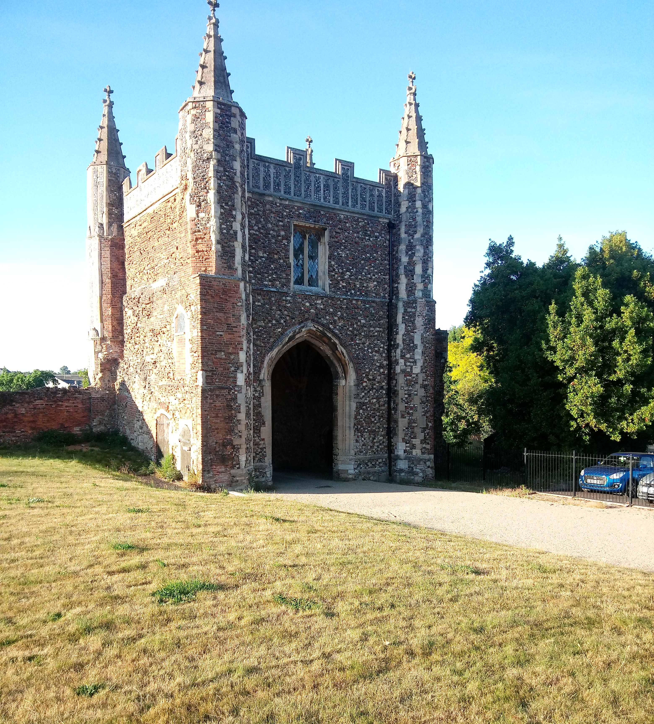
Laura Davison, Project Manager
My role
The aim of the project
Duration
Onesquaremilelaura@stjohnsgreen.org.uk

Slide 4
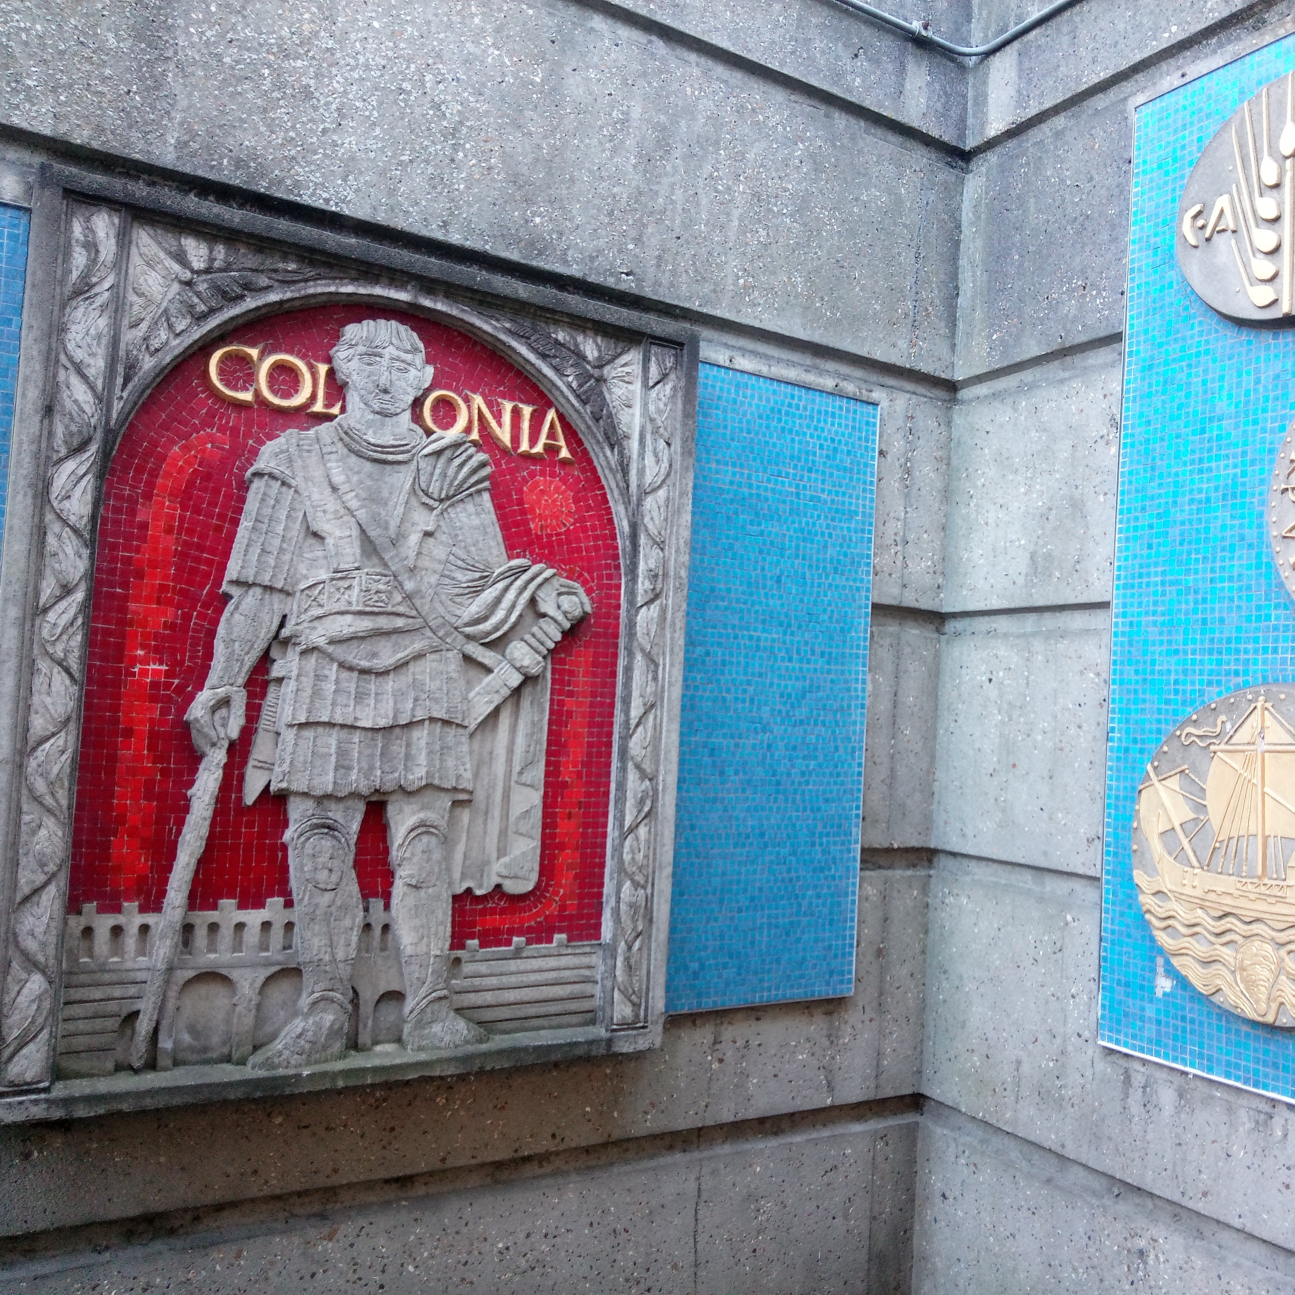
How will we do this?
Each year group to have a dedicated research topic.
Supported by our specialist freelance team and project supporters.
For you to go and meet the experts, learn about the heritage on our doorstep.
Take the pupils out to look at and research the heritage sites.
Bring the research together as a teaching resource.

Slide 5
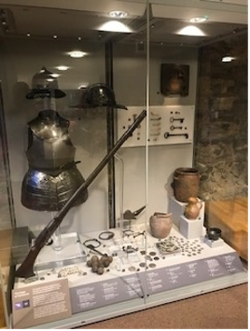
Our Project Supporters
Colchester Civic Society
Colchester Archaeological Trust
Colchester Museums
Colchester Garrison
Colchester Recalled
Essex Record Office

Slide 6
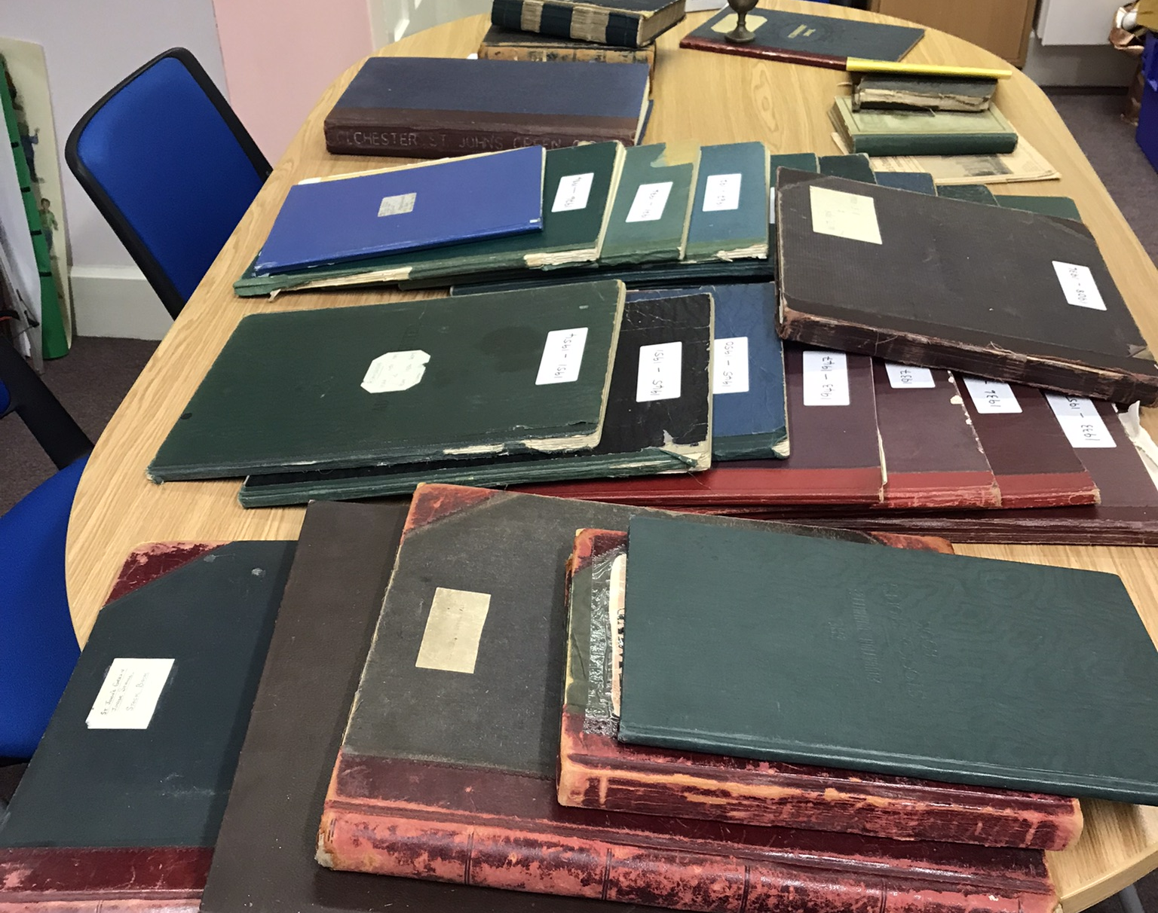
Claire Driver,
Historian
onesquaremileclaire@stjohnsgreen.org.uk
Claire's background is in local history projects, oral history and community archives
She has an overview of Colchester’s heritage sites and history and is excited to find out more
Her role is to support teachers in signposting local sites, resources, supporting ‘Go and See’ meetings with partners including the ERO on the next two Mondays. I can be available online or in person on Mondays to help too.
She is indexing and packaging the school archive that we’ll be making use of in year 2

Slide 7
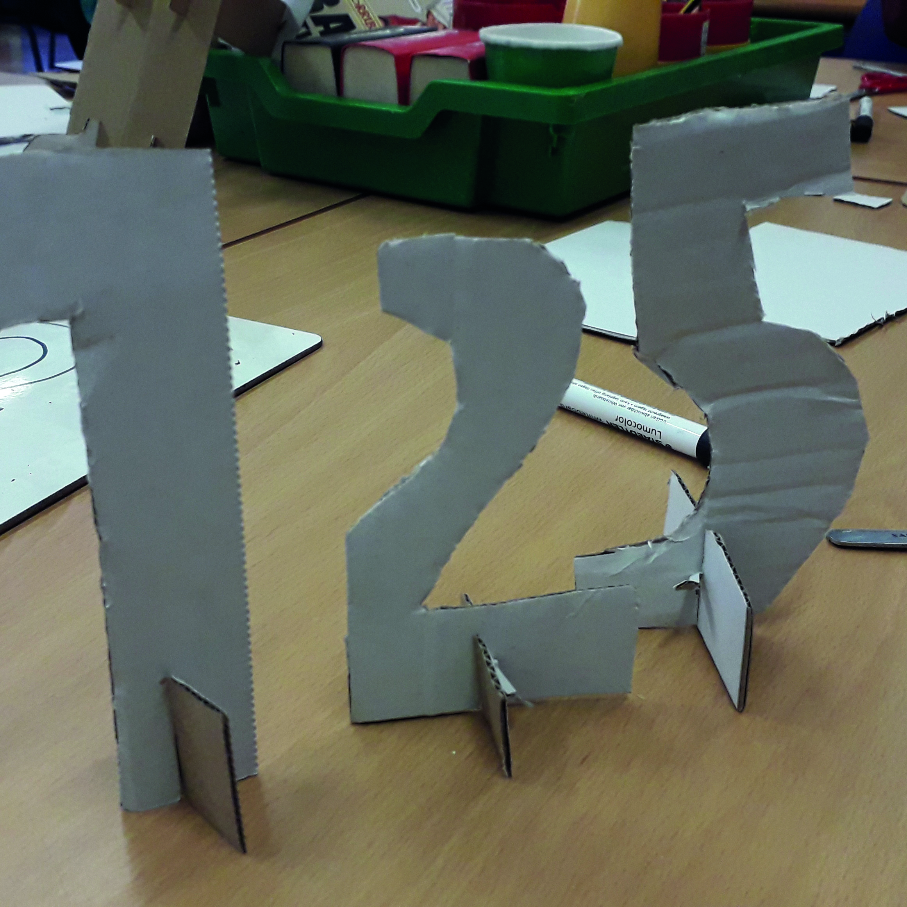
Nicola Burrell, Artist
Nicola’s drawing workshops will focus on the heritage sites and historical themes.
These will be either with the teachers as skills training sessions in drawing, looking and making.
It is likely to be more intense delivery during the summer Term 2023 and autumn term 2023, in which a 3D sculptural response might be made.

Slide 8

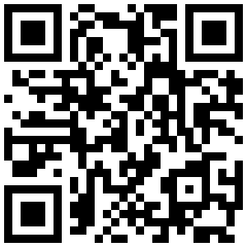
John Wallett, Designer
John will work with Nicola & Claire to bring together the creative and research work produced by pupils and explore ways to make interactive maps of time and place.
Project website link and QR code:
https://one-square-mile.online

Slide 9
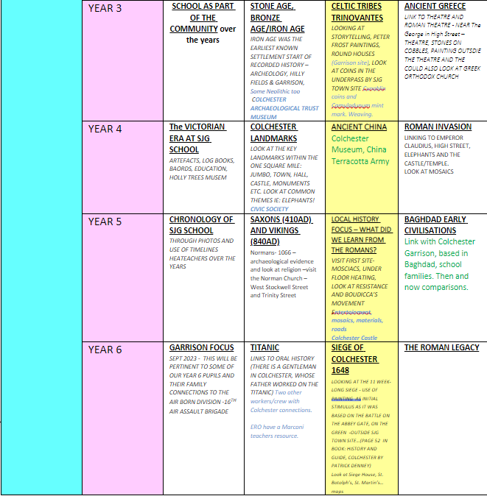
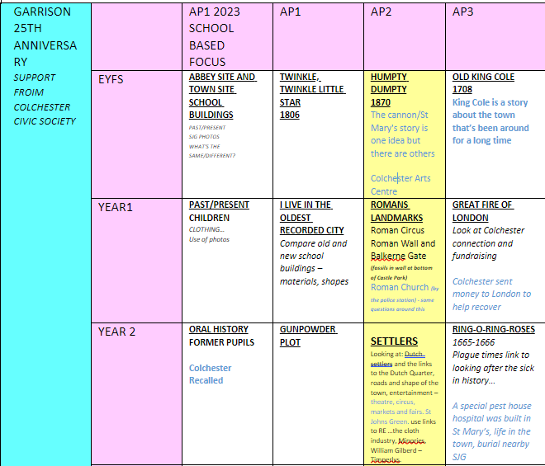
One Square Mile LTP
LTP

Slide 10
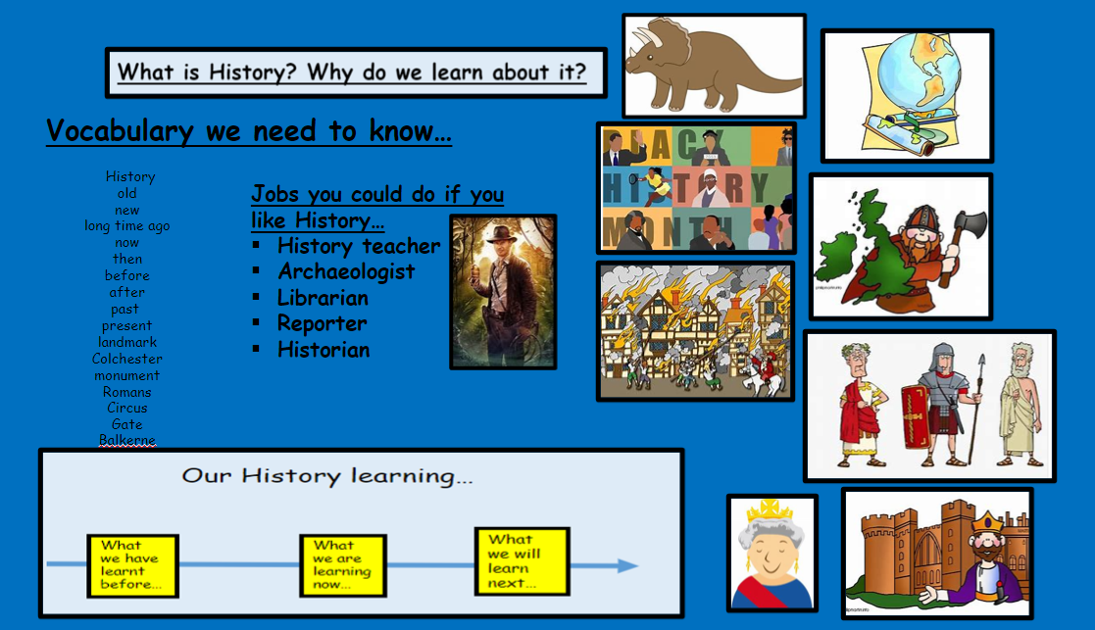
Example of Planning

Slide 11
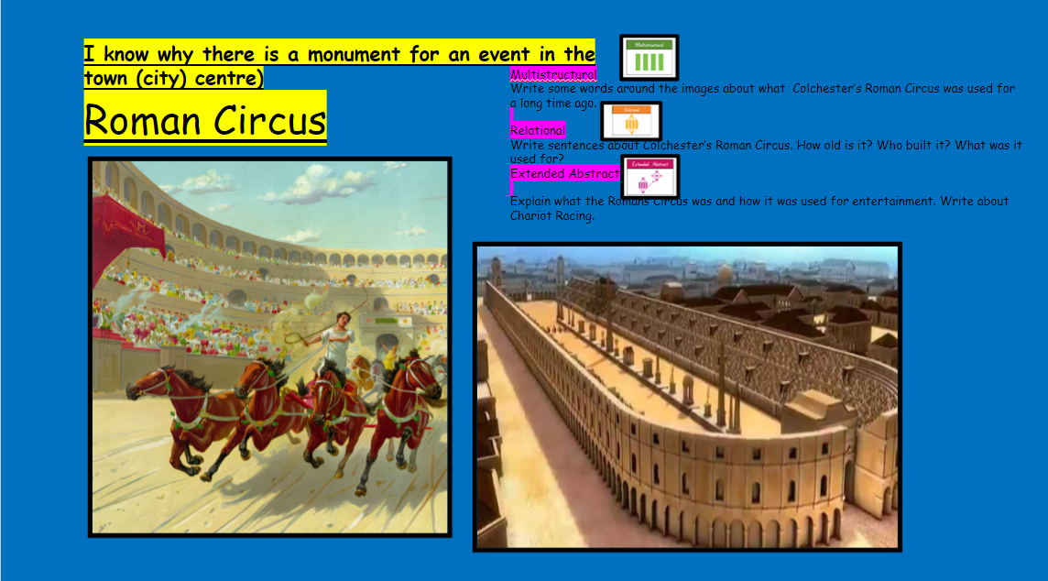

Slide 12
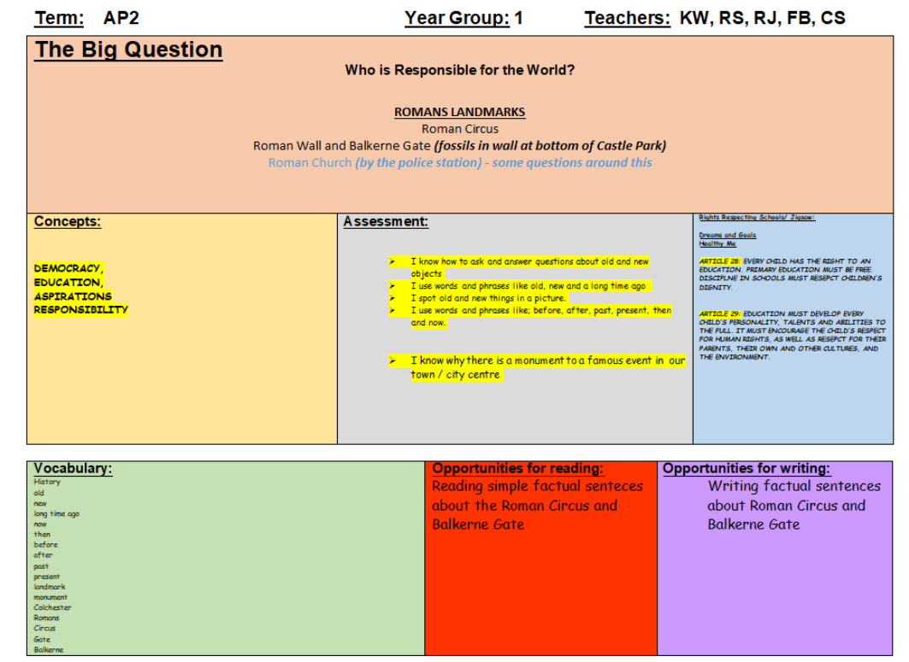
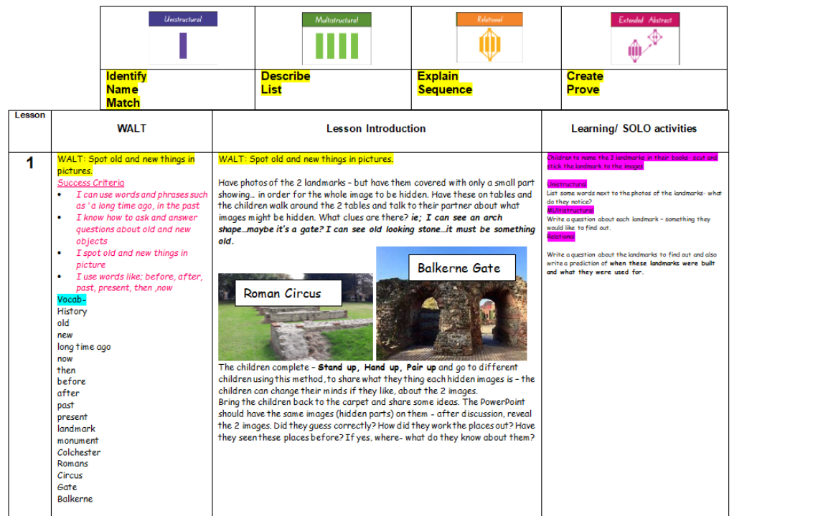
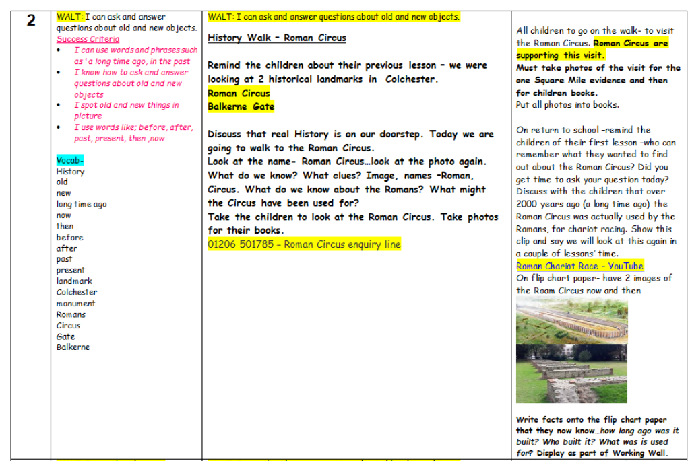
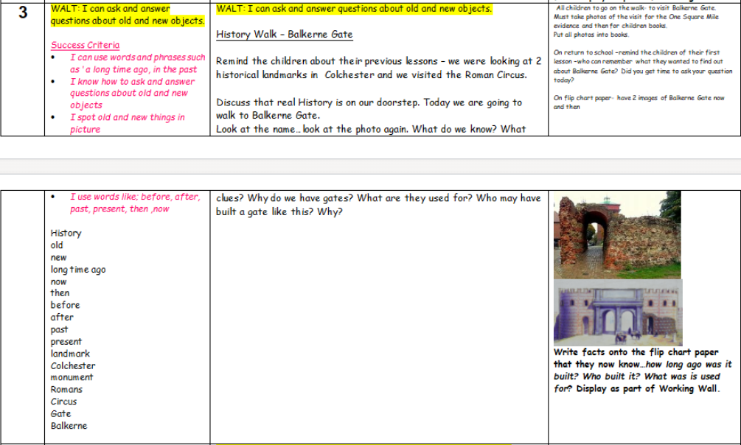
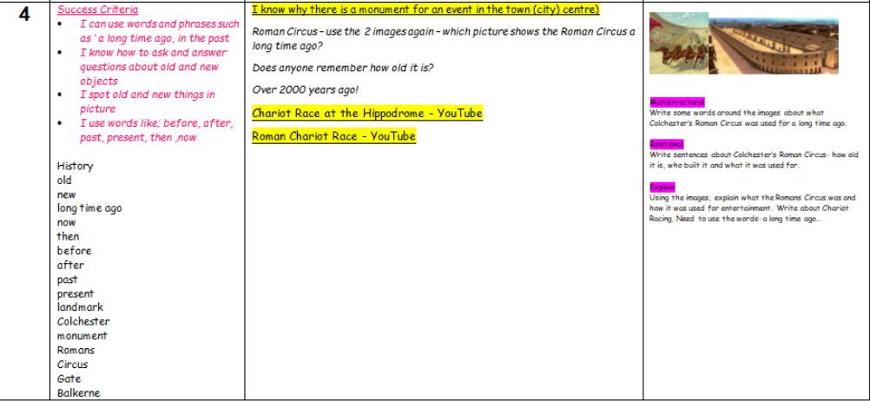

Slide 13
Joanne Locke, External Evaluator onesquaremilejoanne@stjohnsgreen.org.uk
Evaluation – relevant to teachers
When? Start + End + significant moments throughout (e.g. teaching, school workshops, focus groups, staff meetings, staff training)
How? Microsoft Form surveys + interviews + workshop observations + photos + emails
Why? Requirement of Heritage Lottery Fund grant (outcomes for heritage, people and communities) + supports all involved to reflect on WWW and EBI
How can you help? Suggest improvements to methods + complete as many surveys as practical + email me feedback and photos + email me when you have organized events that you think I should observe + let me know how I can help you

Slide 14
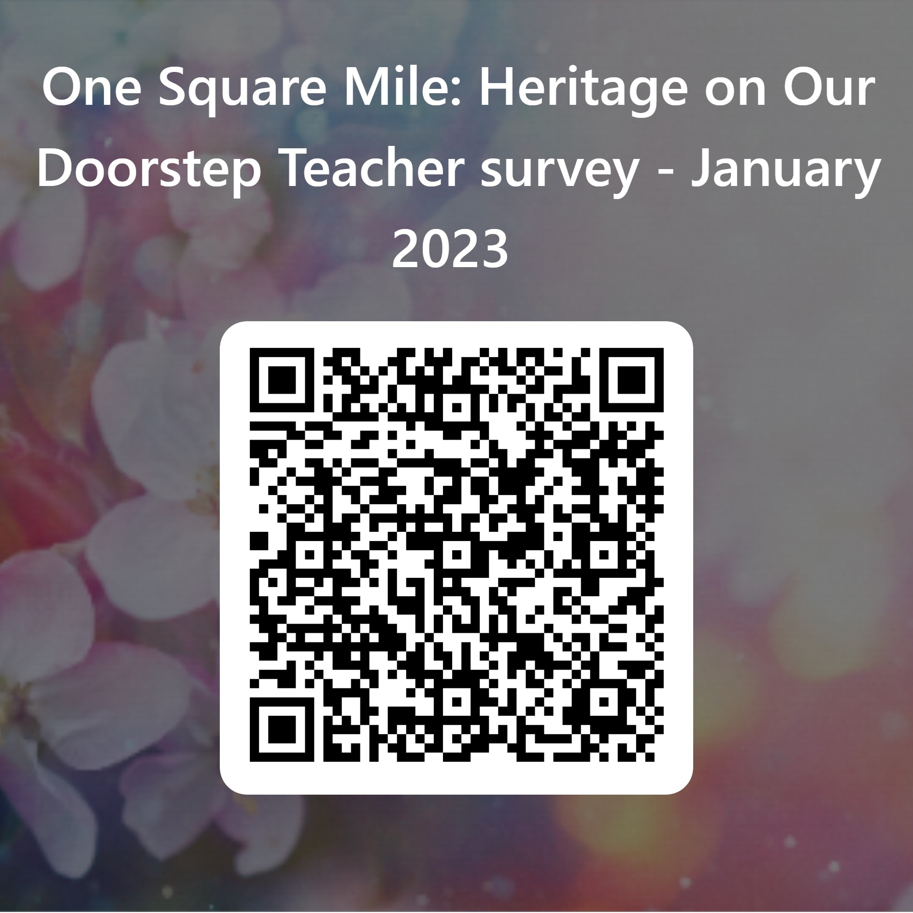
Baseline Evaluation Survey
Or use this url if you cannot scan QR code …
https://forms.office.com/e/LBbbuCyfii

Slide 15
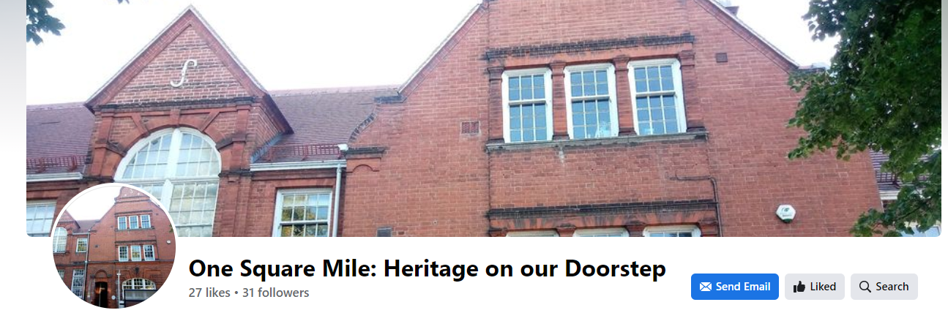
Contacts
Email onesquaremilelaura@stjohnsgreen.org.uk
Web page: https://one-square-mile.online
Facebook https://www.facebook.com/profile.php?id=100086912204893 One Square Mile: Heritage on Our Doorstep

